Slide 1
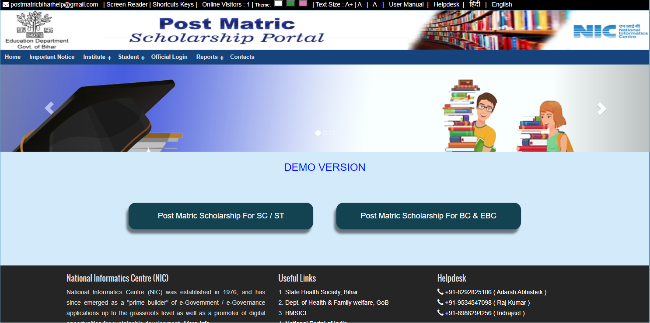
Welcome Page (Institution Registration)
Institute Registration

Slide 2
User Management
1.Institution
2. Student
3. District
4. TPA
5. Department

Slide 3
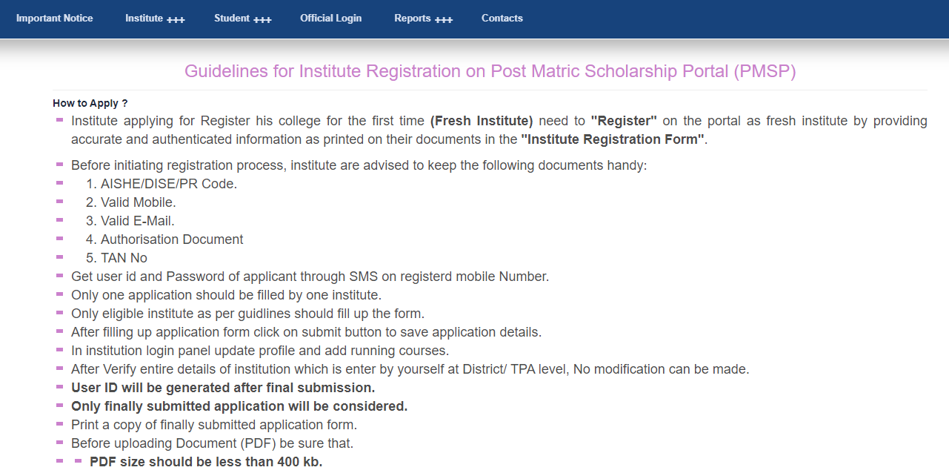
Institution Registration (Guidelines before Registration-1)

Slide 4
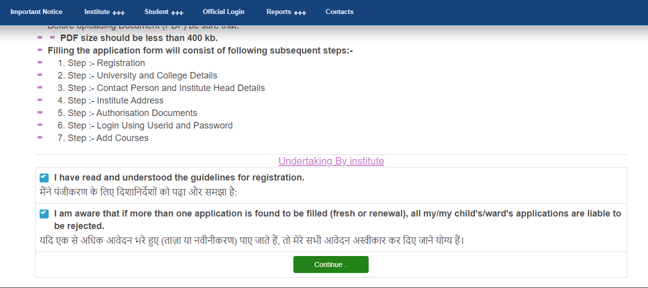
Institution Registration (Guidelines before Registration-2)

Slide 5
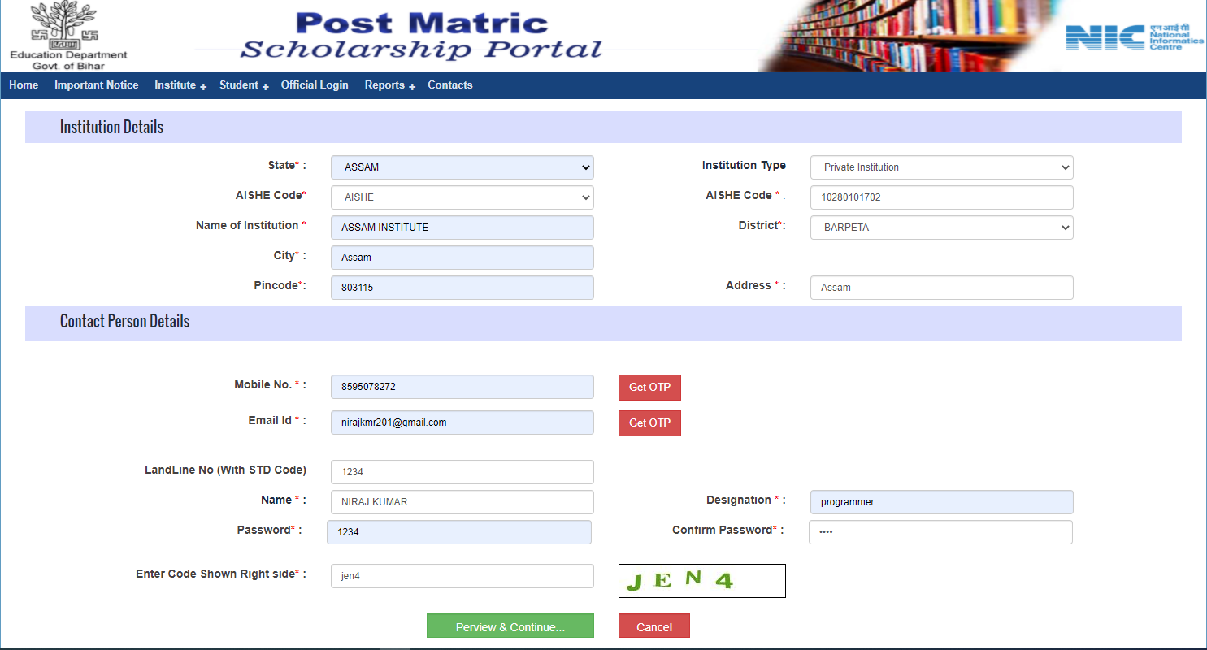
Institution Registration (Part - 1)

Slide 6
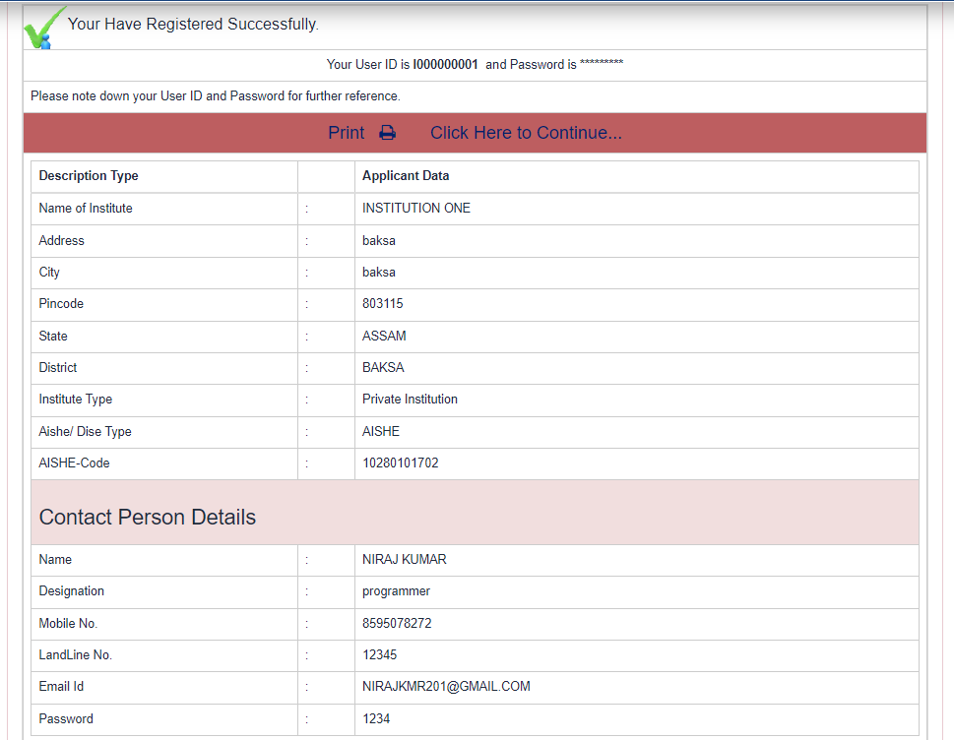
Registration Success Message

Slide 7
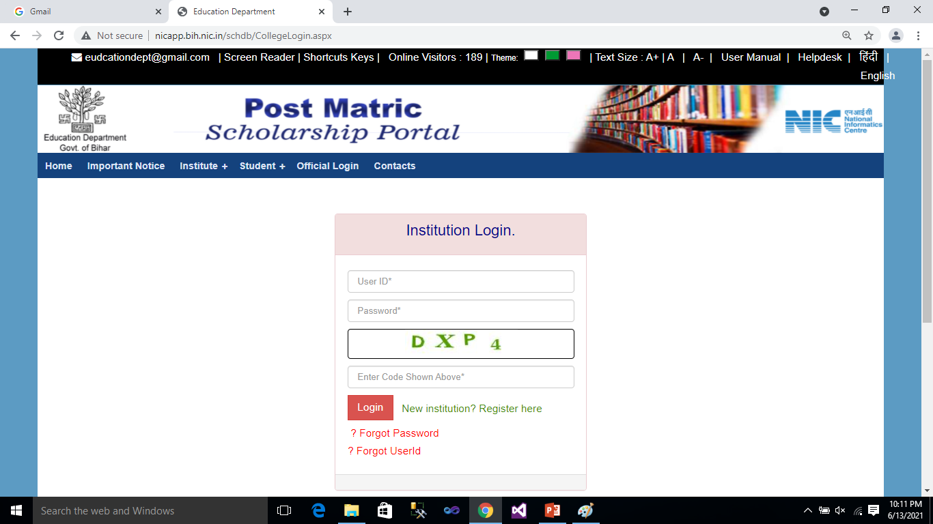
Institution Login

Slide 8
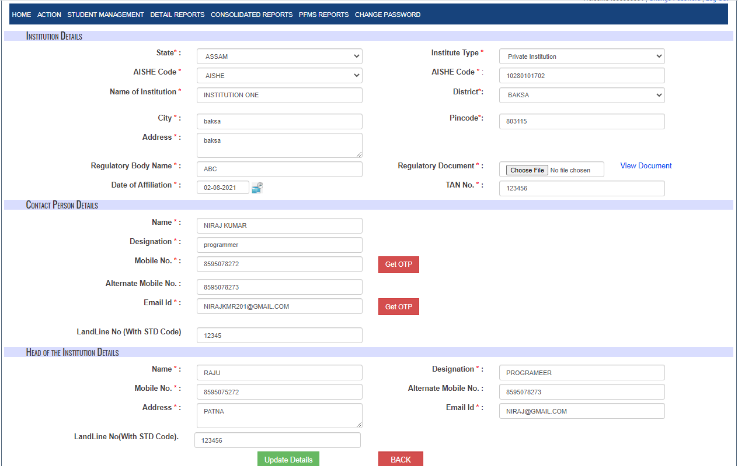
Update Institution Details

Slide 9
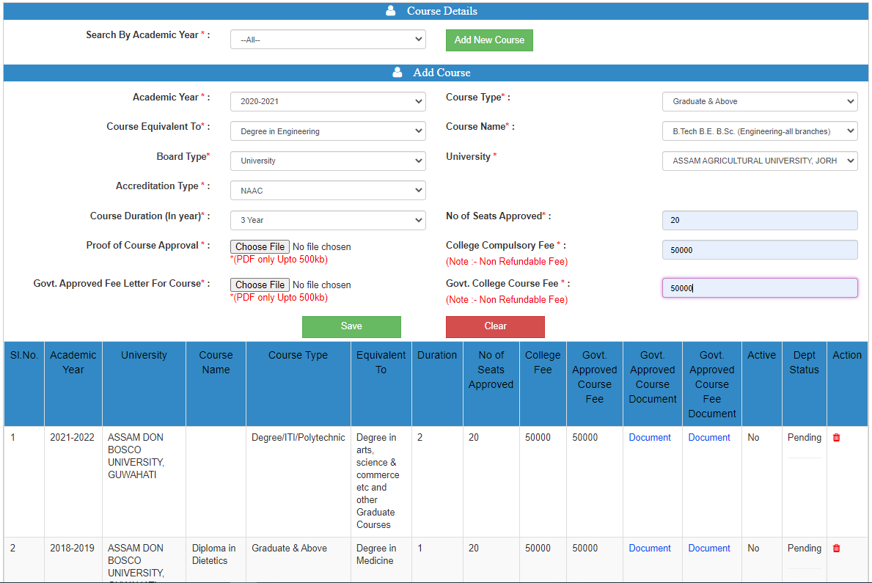
Add Course

Slide 10
Official Login( for Institution Approval)
1.HQ Operator – For Temporary Approval of Institution so that Student can start Registration in that institution.
2. District / Block Admin – For Approval of Institution in Bihar
3. TPA – For Approval of Institution Outside Bihar

Slide 11
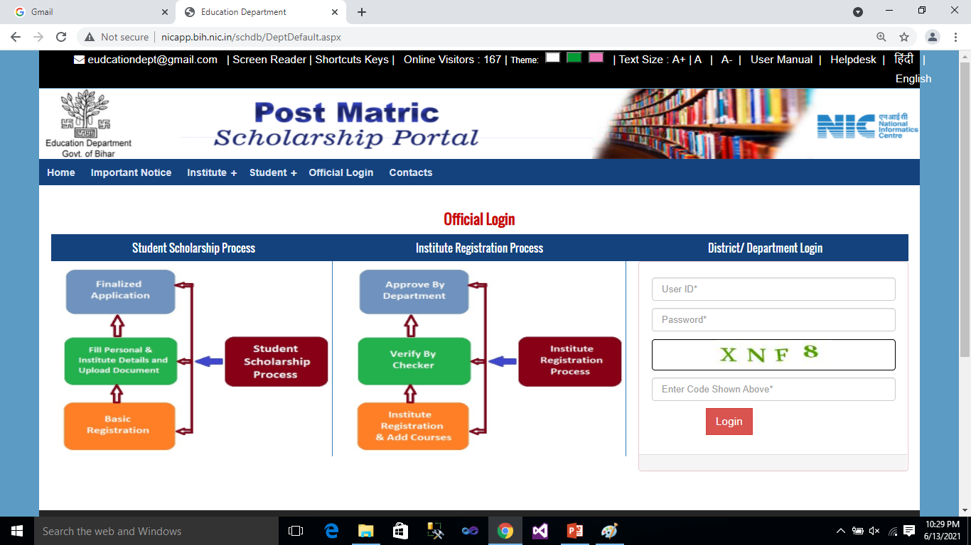
Official Login( for Institution Approval)

Slide 12
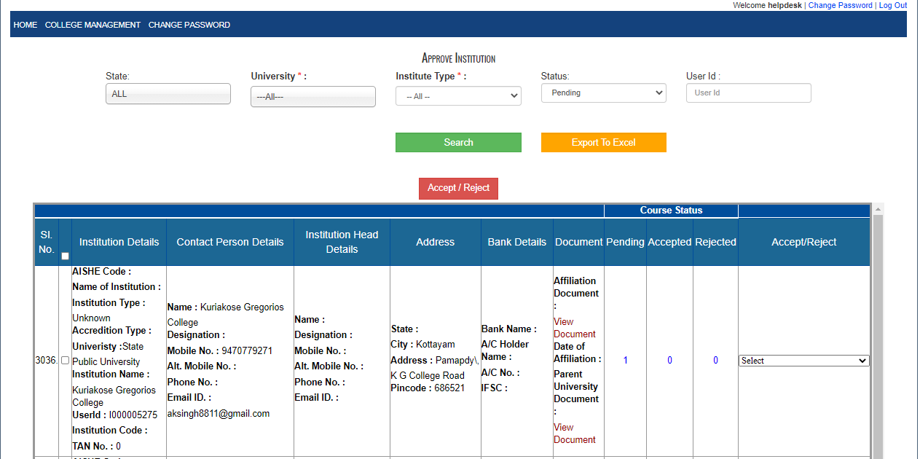
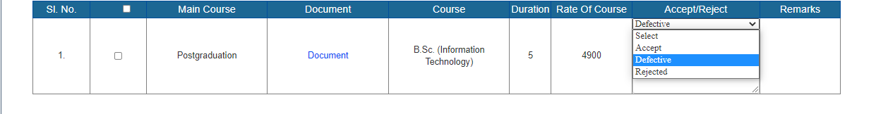
Institution and Courses Temporary Approval (HQ Operator)

Slide 13
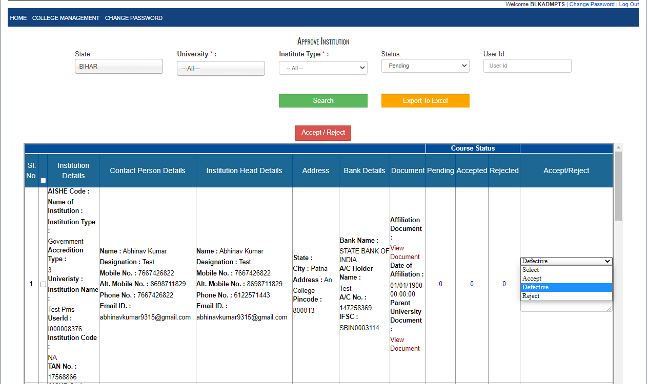
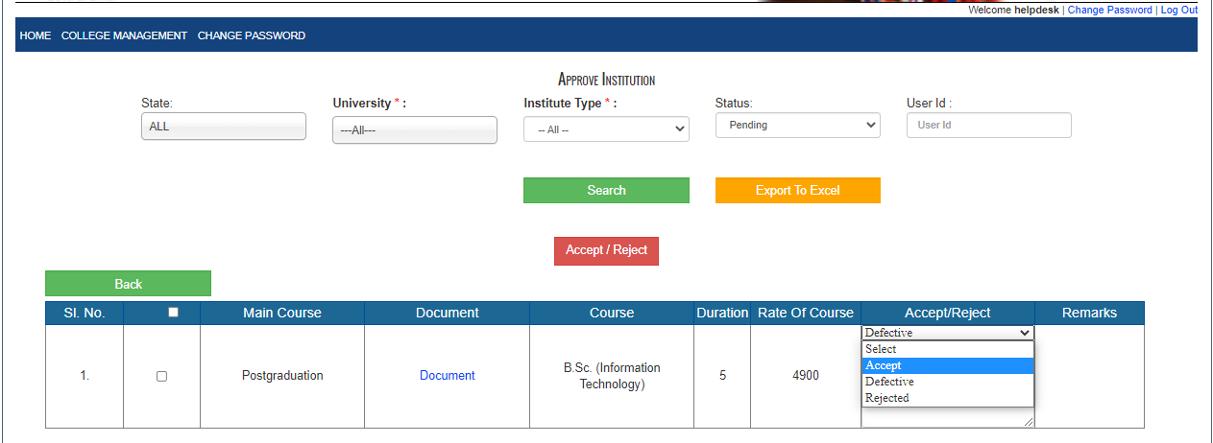
Institution and Courses Approval- For Bihar (District / Block )

Slide 14
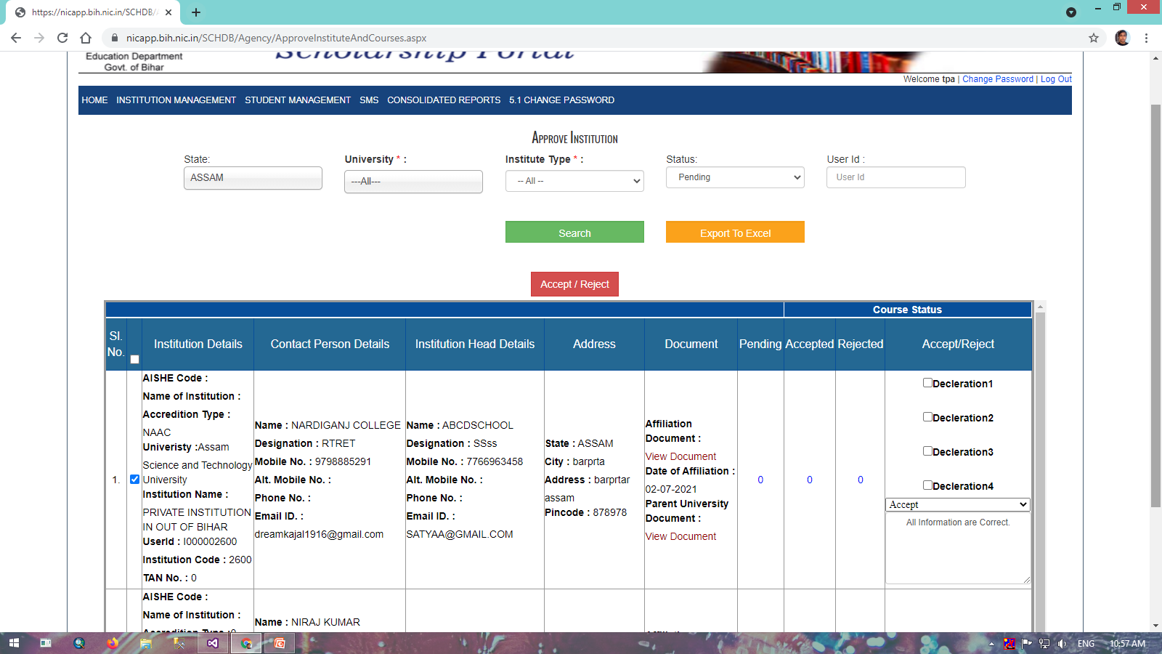
Institution and Courses Approval- For Outside Bihar (TPA )

Slide 15
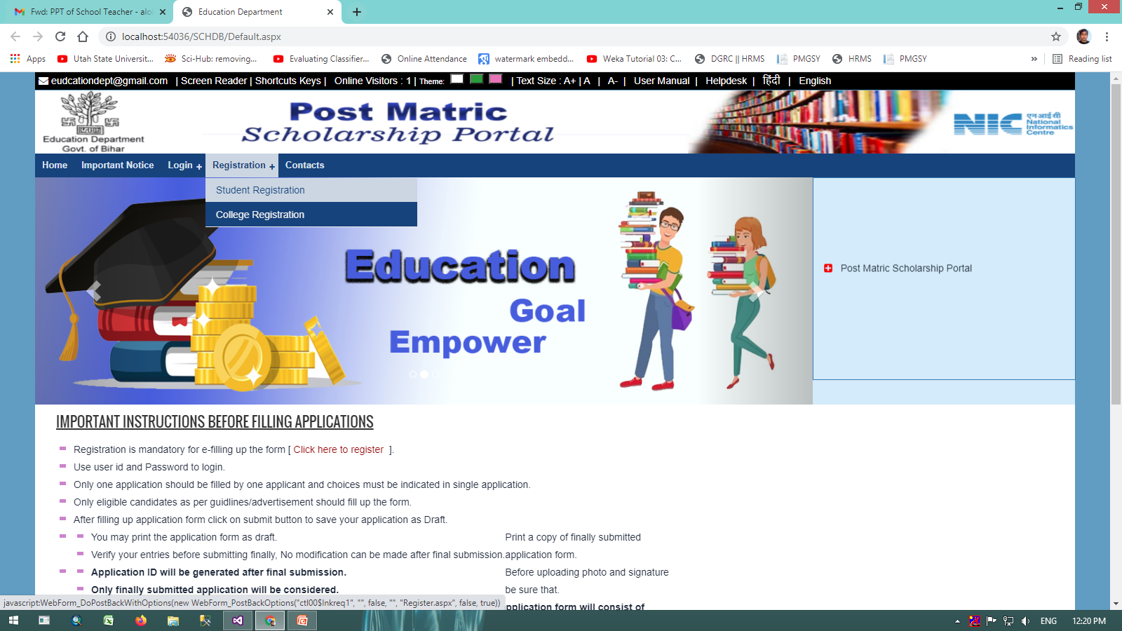
Welcome Page
Student Registration

Slide 16
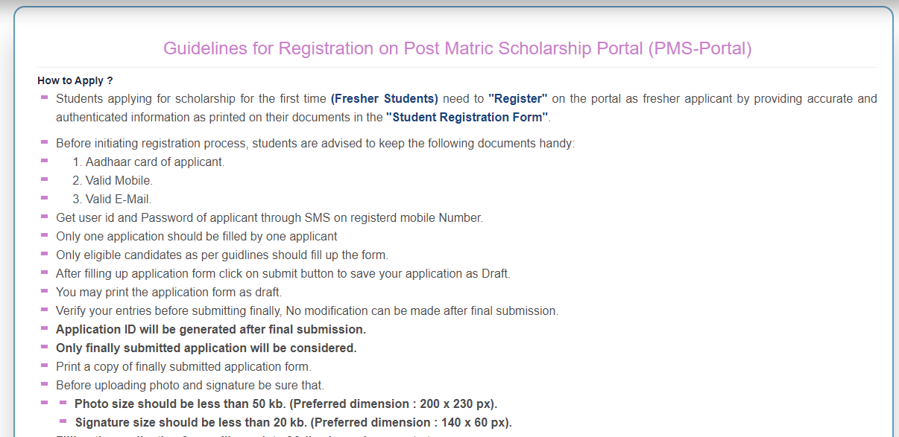
Student Registration(Page-1)

Slide 17
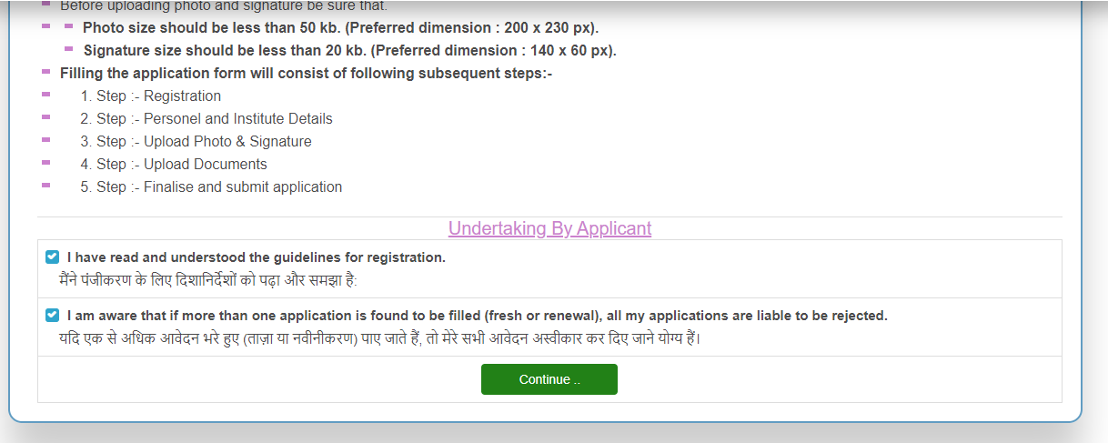
Student Registration(Page-2)

Slide 18
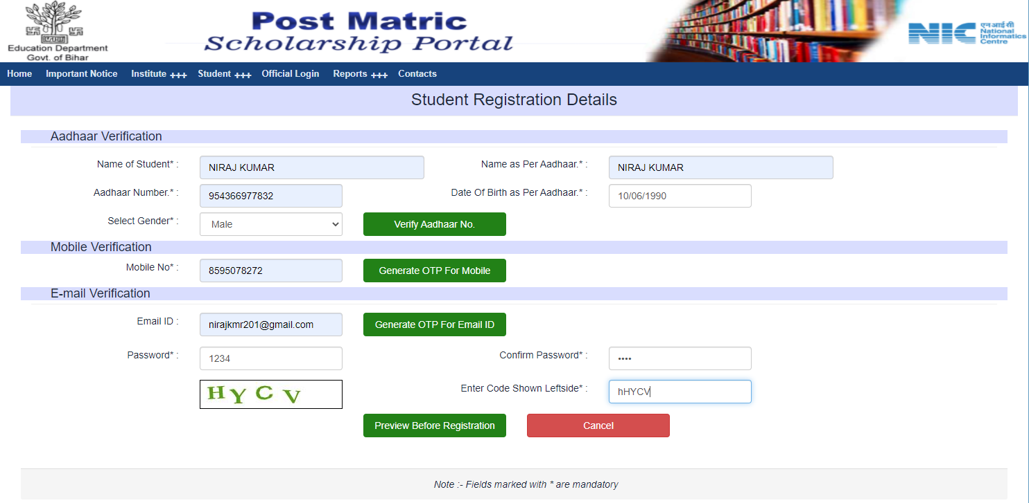
Student Registration(New)

Slide 19
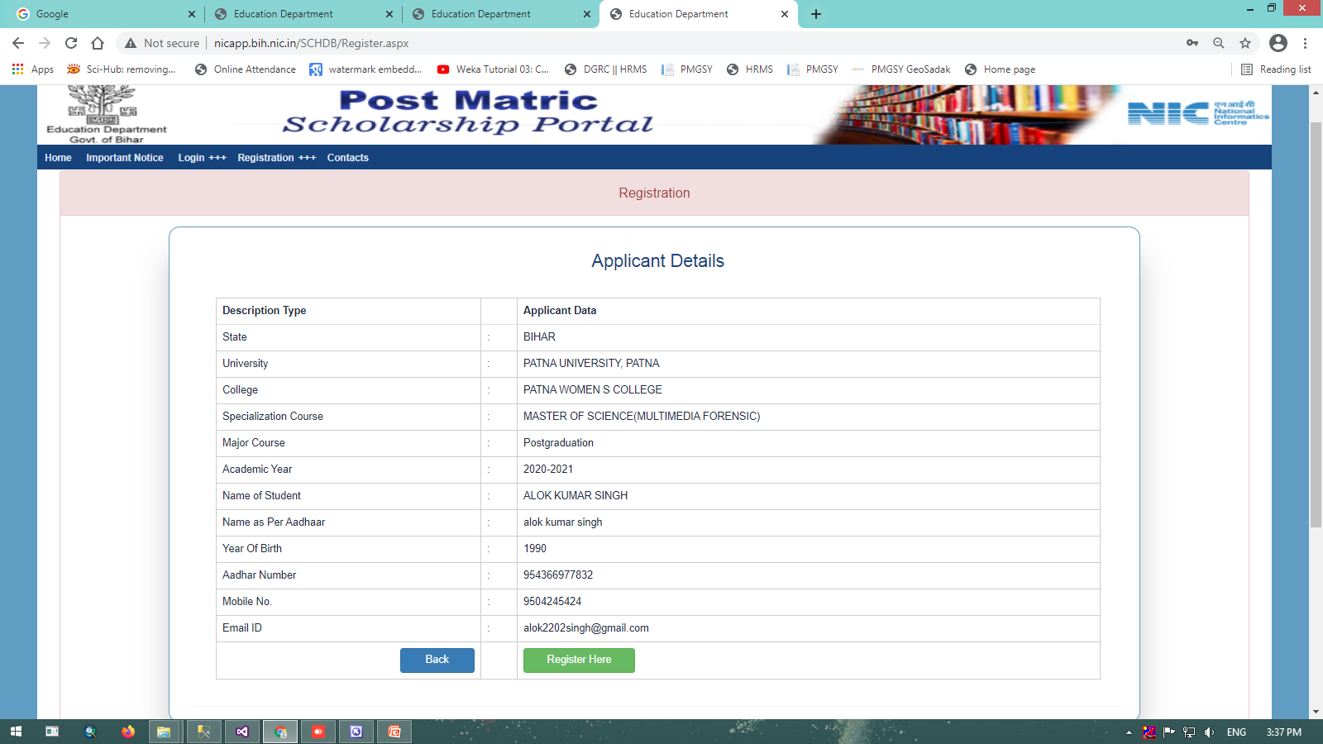
Student Registration(Preview data before Confirm Registration)

Slide 20
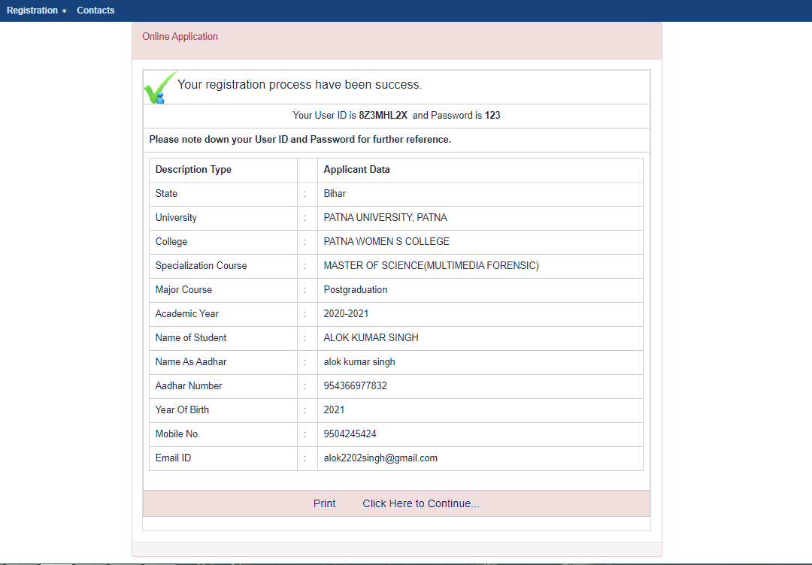
Registration Success Page

Slide 21
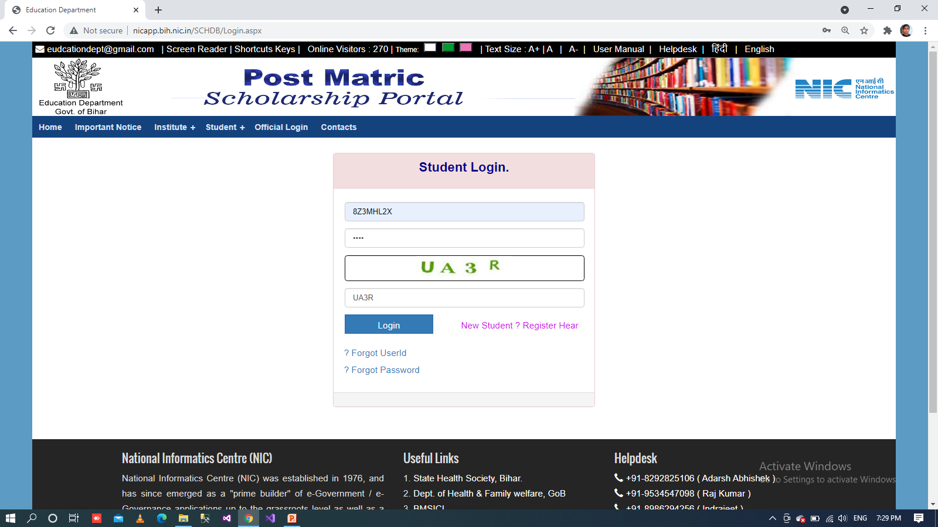
Student Login

Slide 22
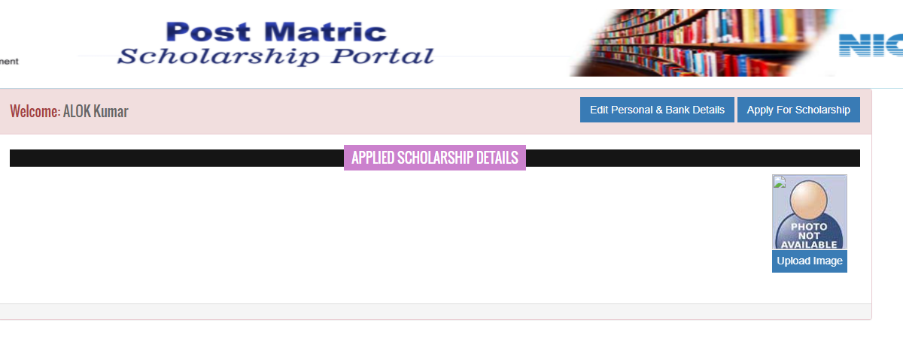
Student Welcome Page

Slide 23
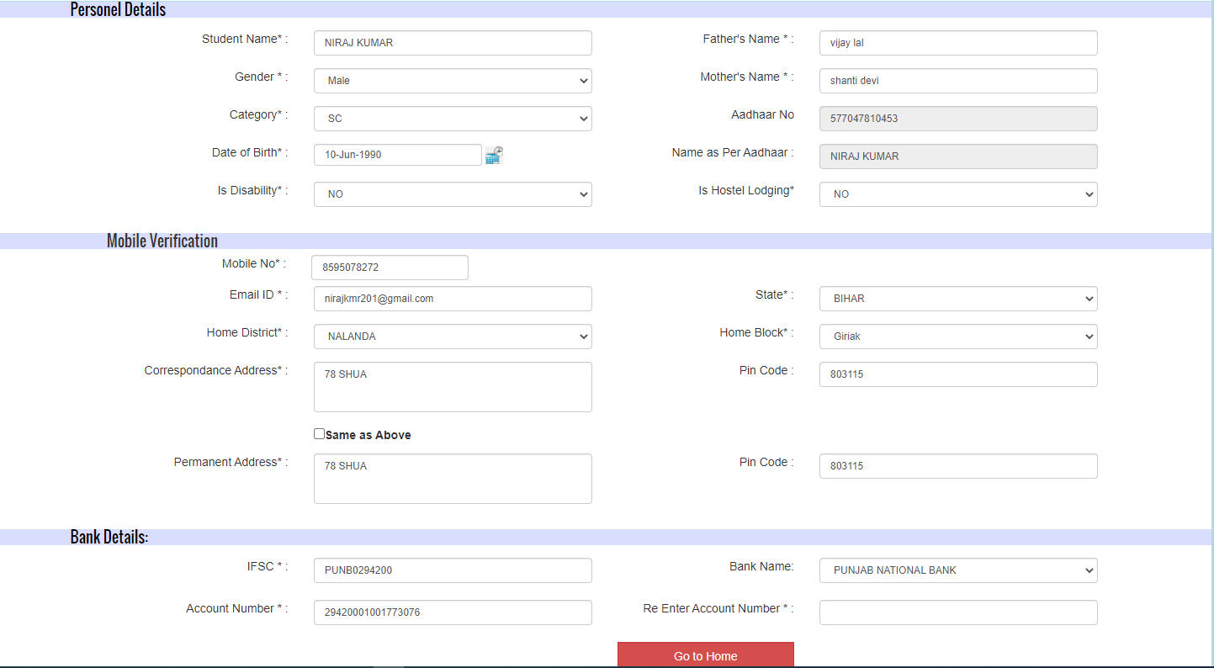
Student Personal Details

Slide 24
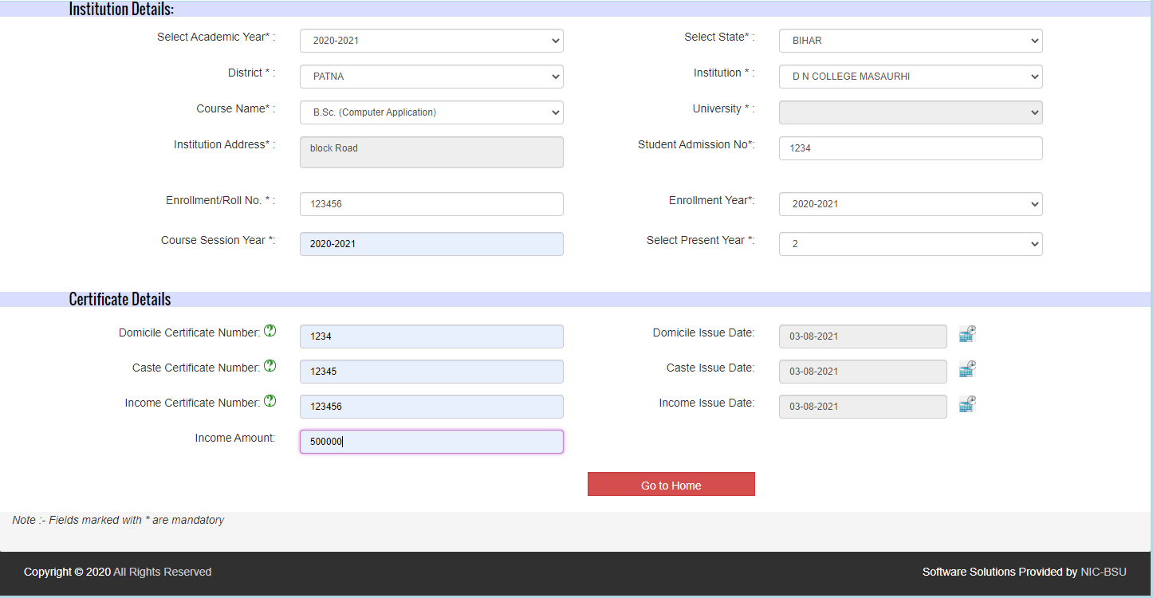
Institution & Certificate Details

Slide 25
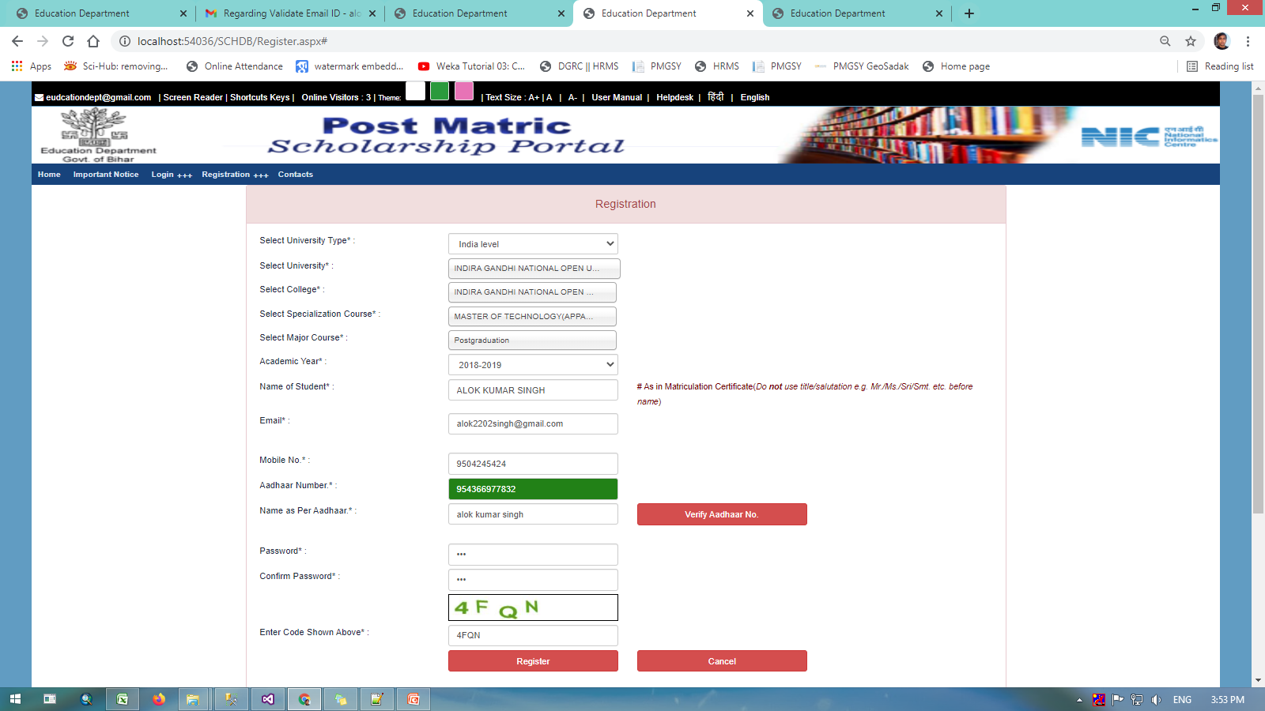
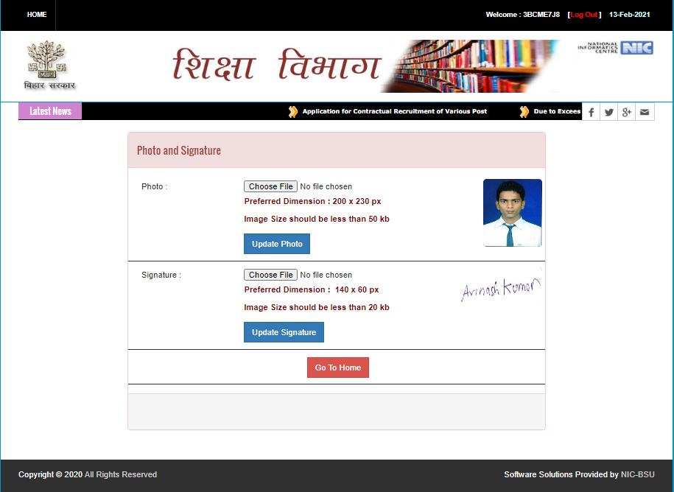
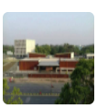
Upload Photo

Slide 26
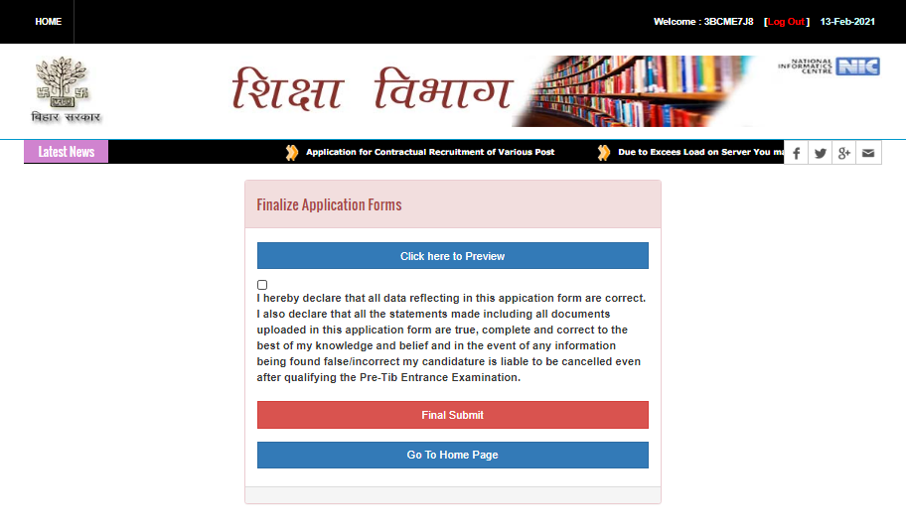
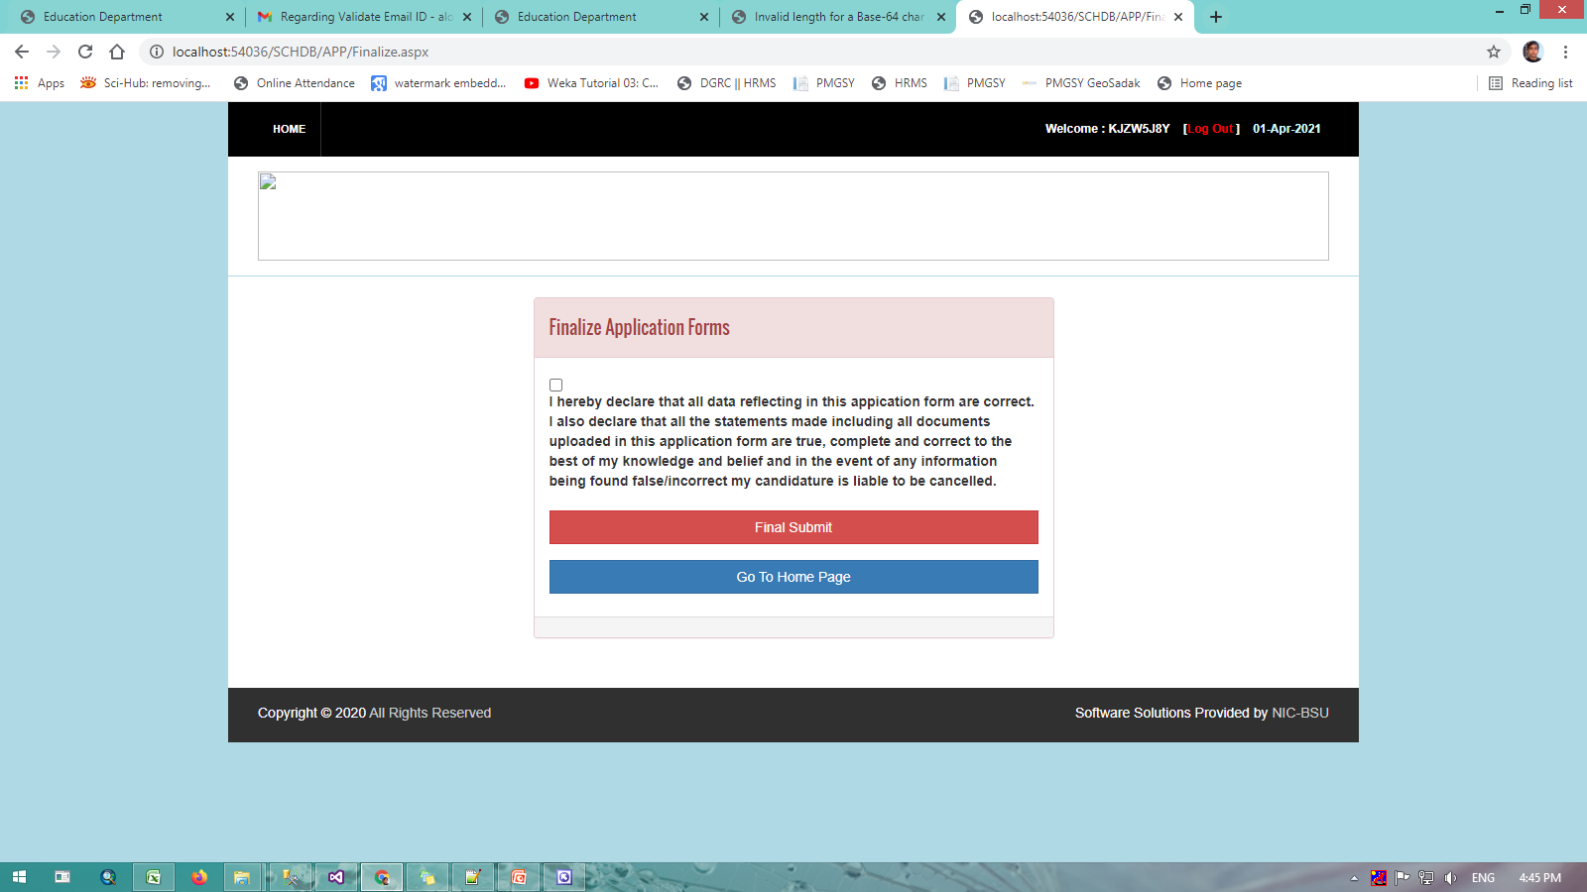
Finalize Application

Slide 27
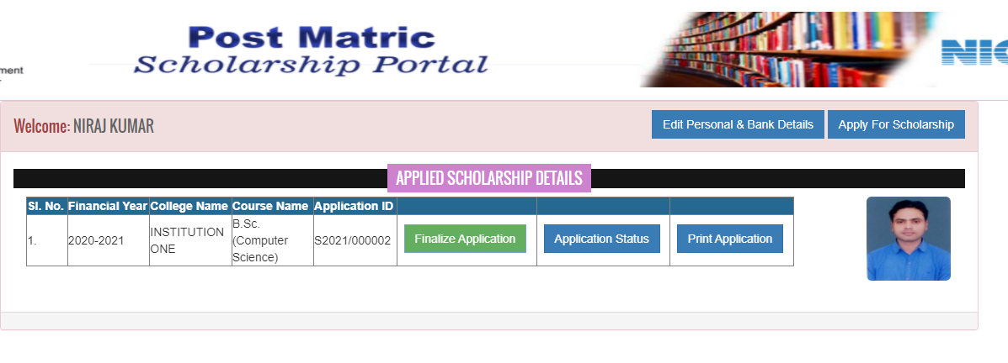
Welcome Page (With Completely Filled all page.)

Slide 28
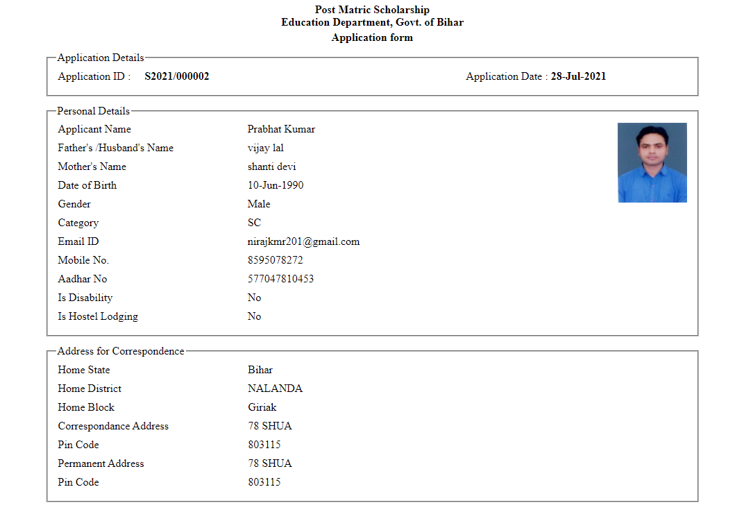
Print Application Form

Slide 29
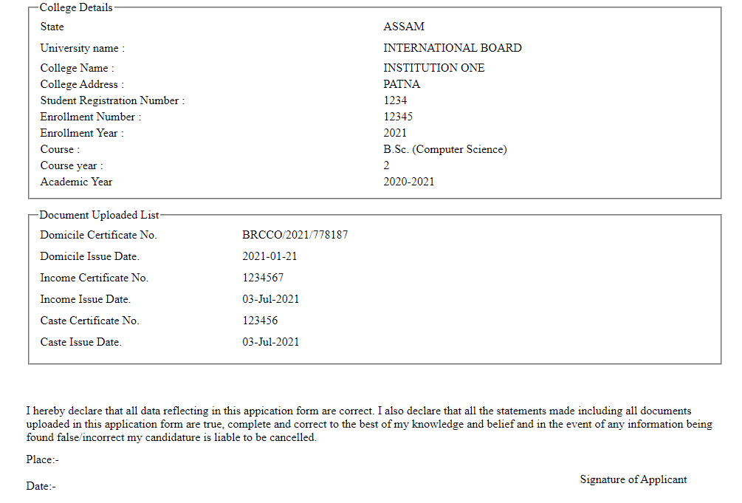
Print Application Form

Slide 30
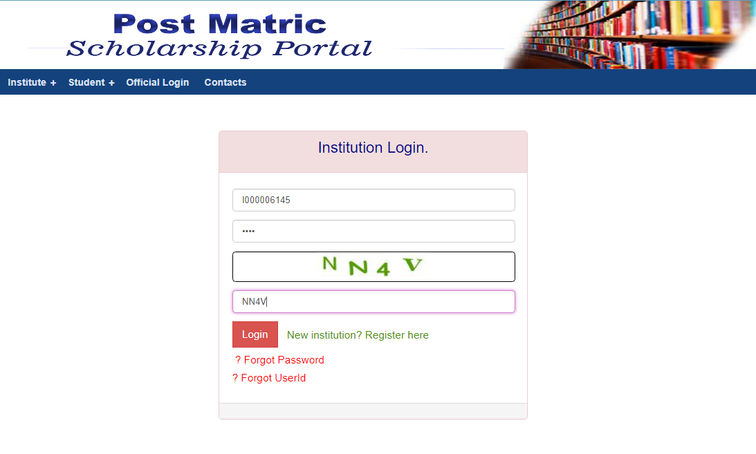
Institution Login

Slide 31
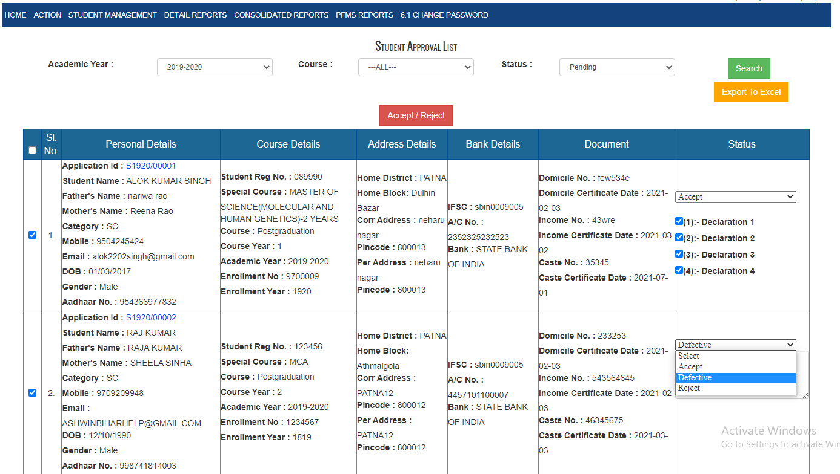
Finalized Student List (In Institution Panel)

Slide 32
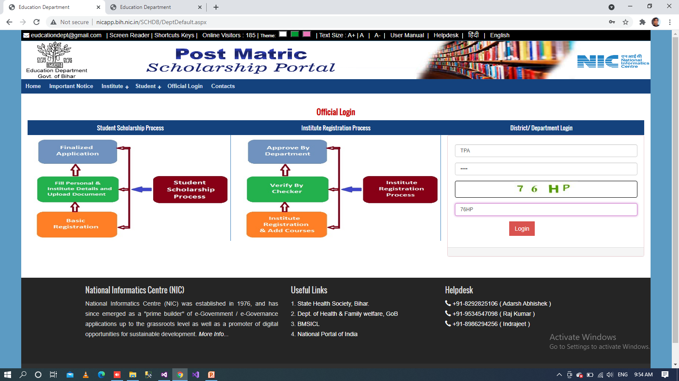
3rd Party Agency Login

Slide 33
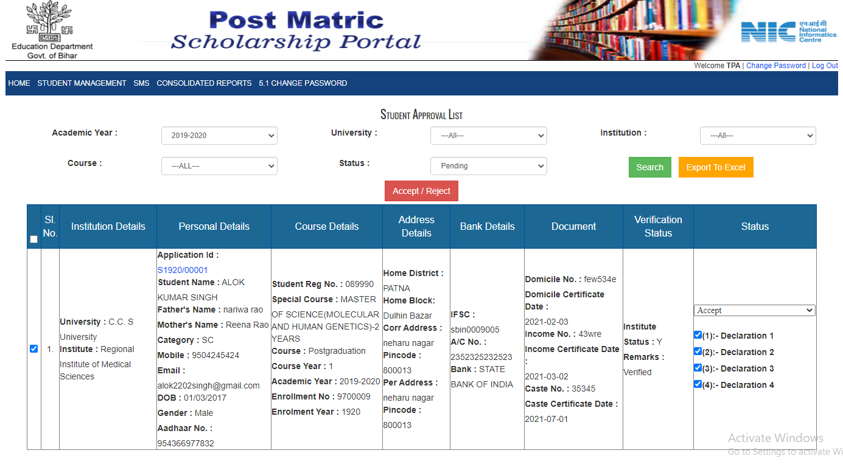
Finalized Student List (In 3rd Agency Panel)

Slide 34

District Login

Slide 35
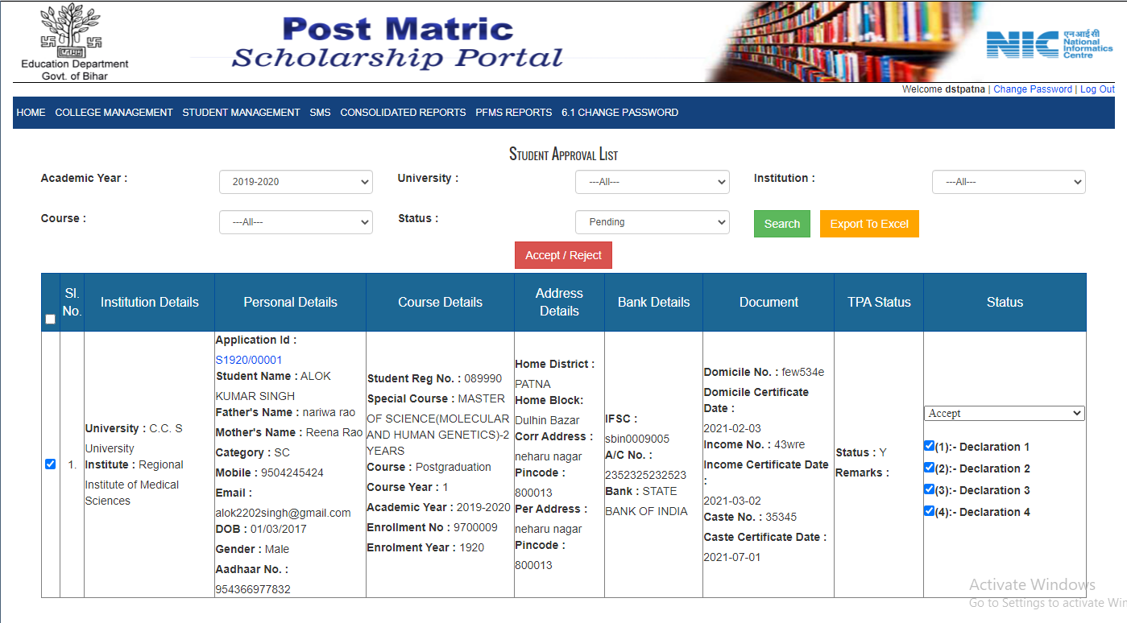
Finalized Student List (In District Panel)

Slide 36
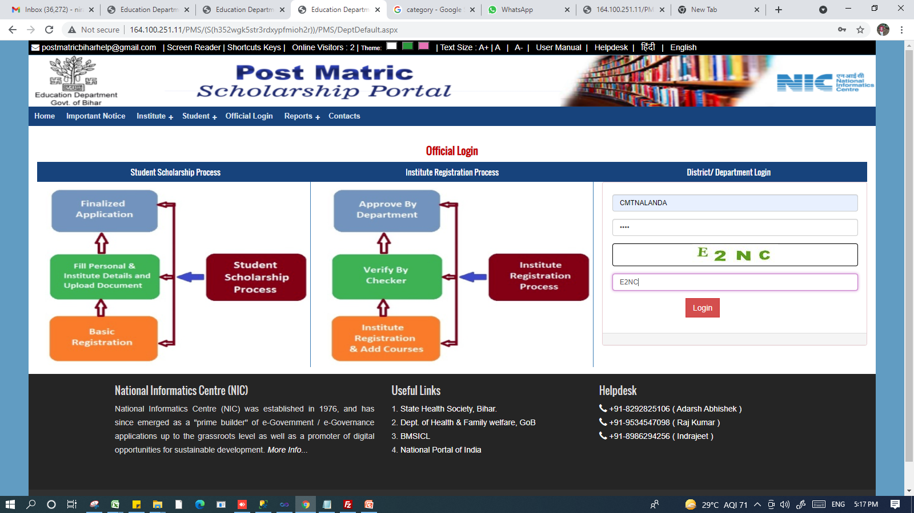
Committee Login

Slide 37
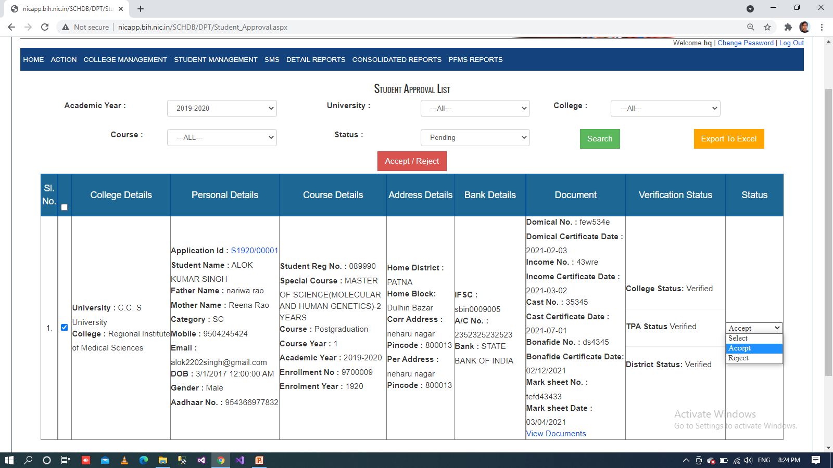
Forward Student List to PFMS for Payment

Slide 38
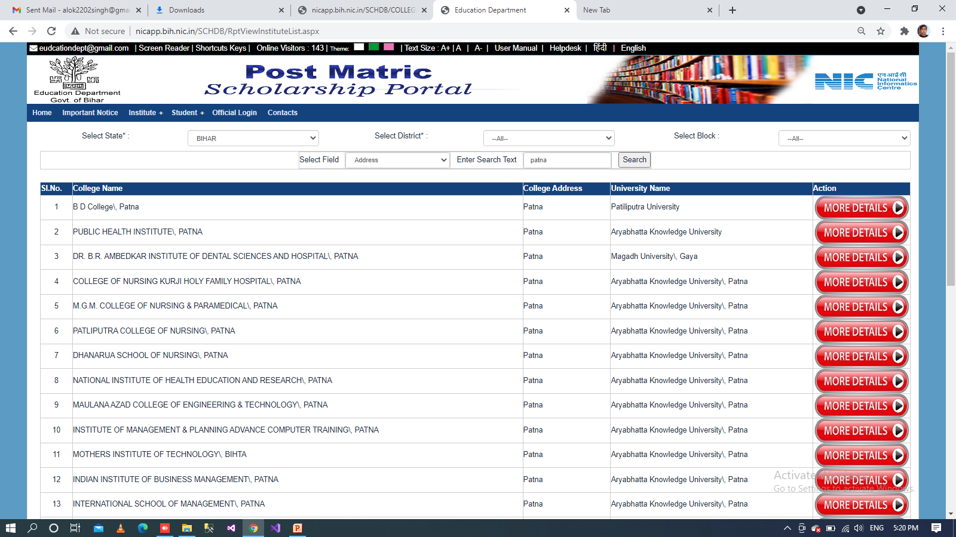
Institute List(Website Panel)

Slide 39
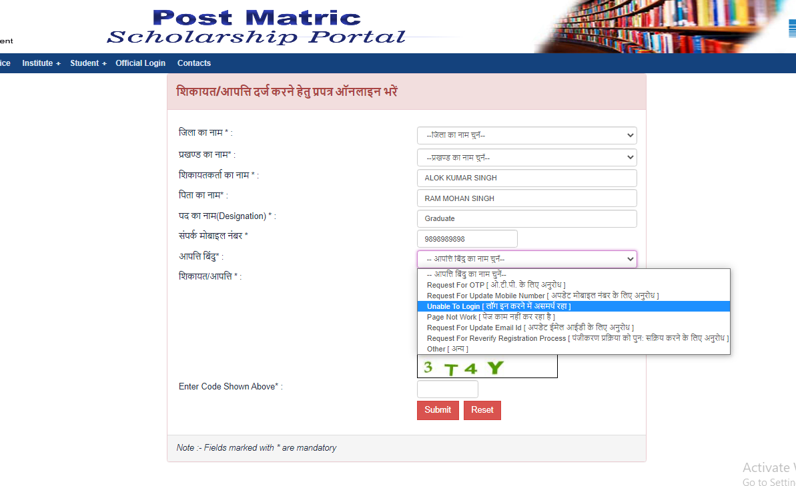
Grievances

Slide 40
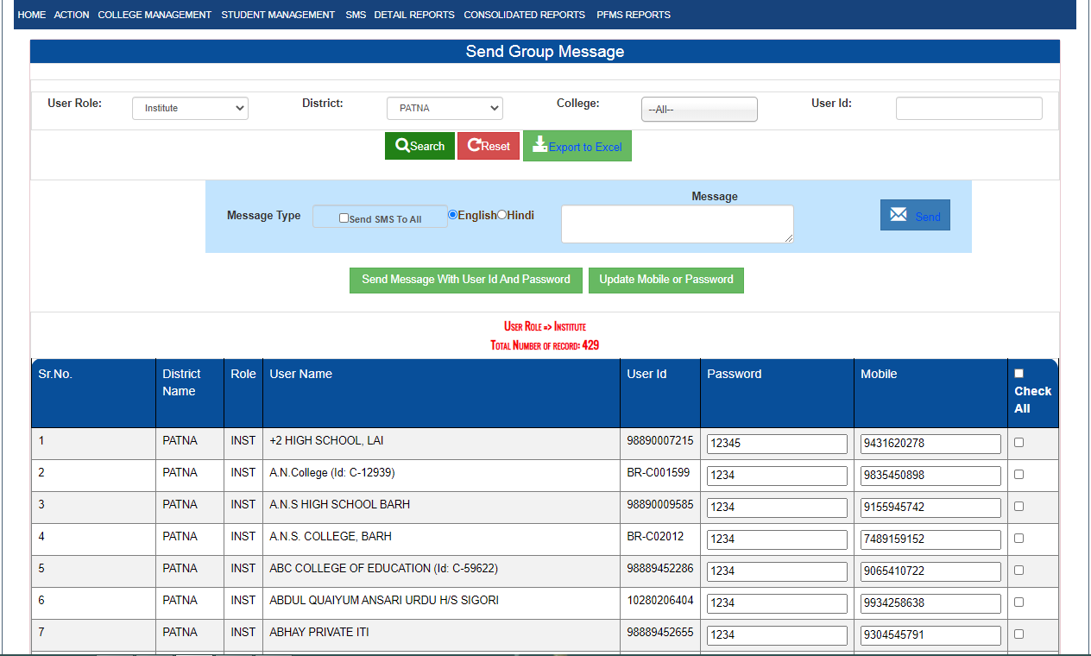
View & Send Credential

Slide 41
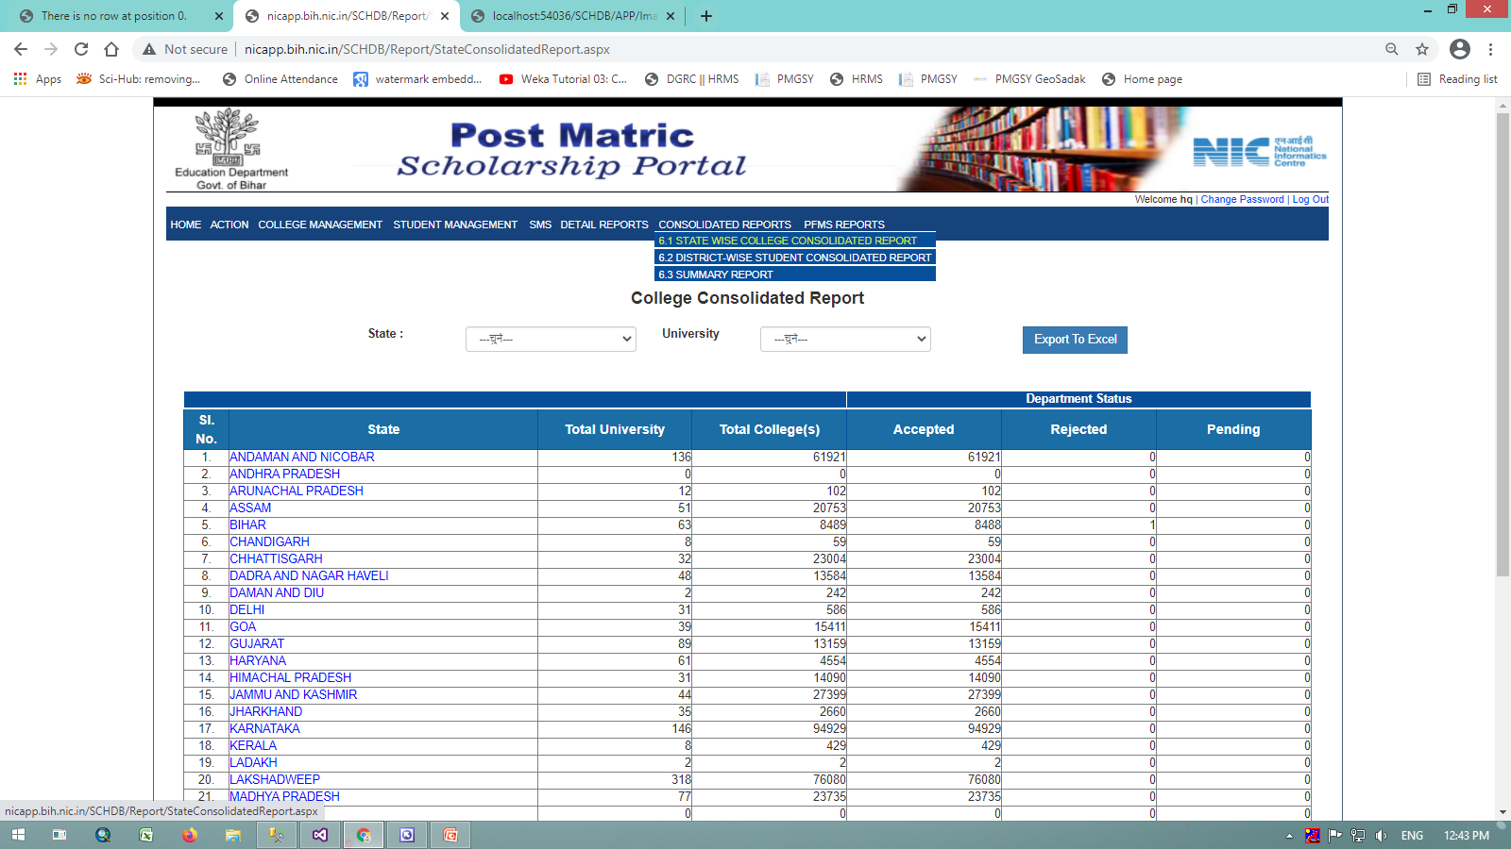
College Consolidated Report (In Department Panel)

Slide 42
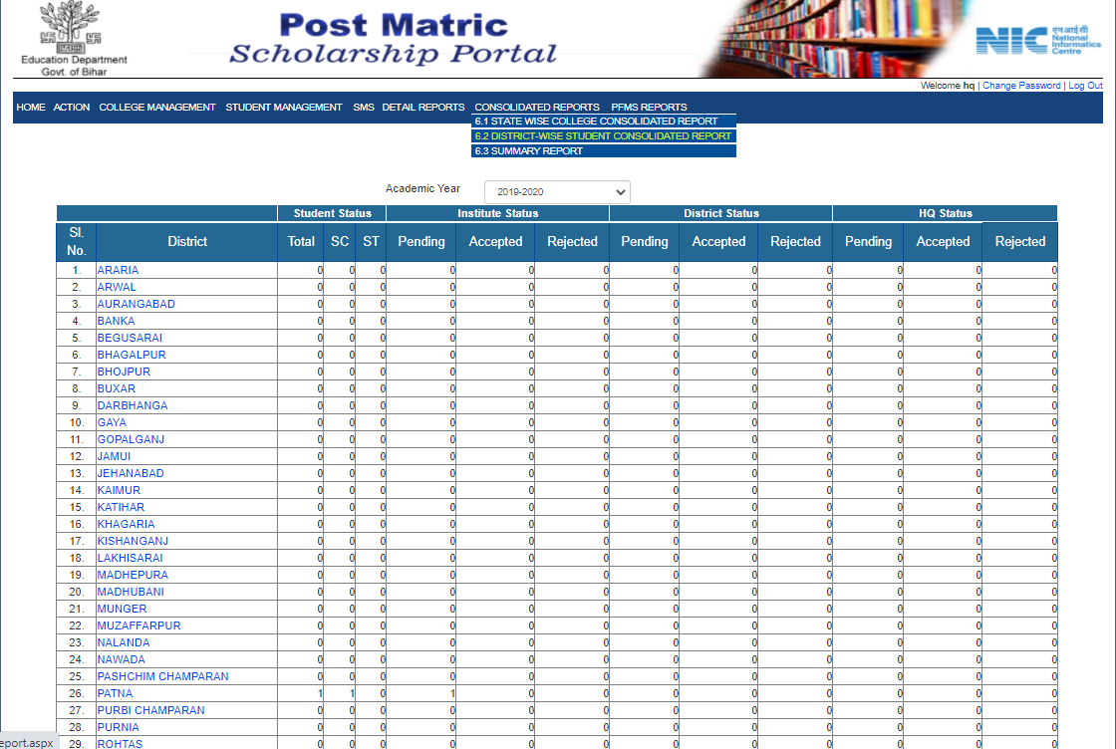
Student Consolidated Report

Slide 43
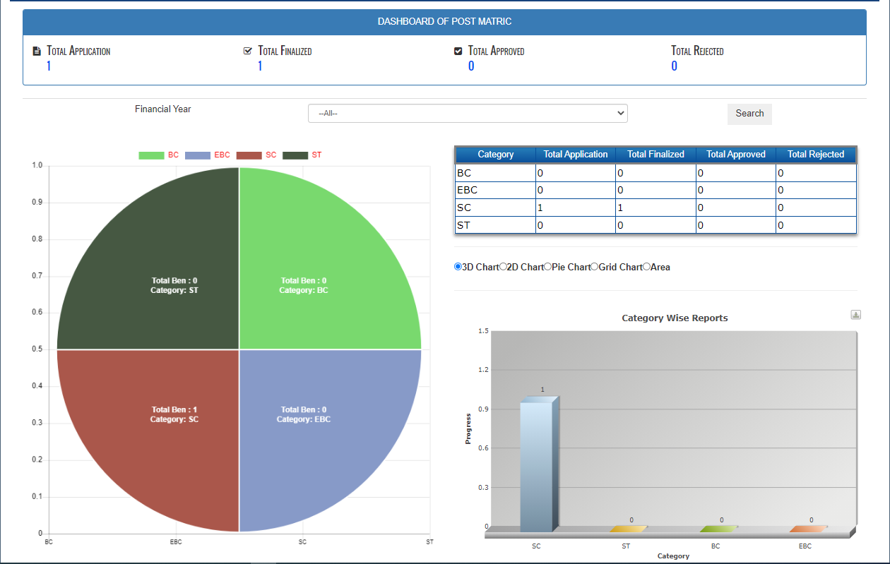
Dashboard

Slide 44
Thank You

